Slide 1
Mini-program for Vehicle Verification
Daisy Du

Slide 2
Contents
Functions
Portal
Instructions
Background

Slide 3







Background
Underwriter’s requirements: validate the latest condition of the car
Transfer Vehicle Ownership:
Deprotection ( start date is later than last date of last year's insurance)
Nonlocal car
Or other special business case
client
agent
send
Take the latest photos or videos of the car
Upload the documents
Notes:
车险核保人对于过户或者脱保或其他业务要求的车辆，需要进行验车环节，也就是需要对车辆的最新状况进行拍照上传系统，便于核保人对车辆情况进行核实

Slide 4
Functions
Mini-program for anyone to upload the files about the car in real -time
The process is tedious and time-consuming
Synchronize the files to all proposal no of this car
Take photos or videos in real-time .Can not select photos or videos from photo album
Authenticity cannot be guaranteed
Record upload location and time of the files and show them to Underwriter

Slide 5
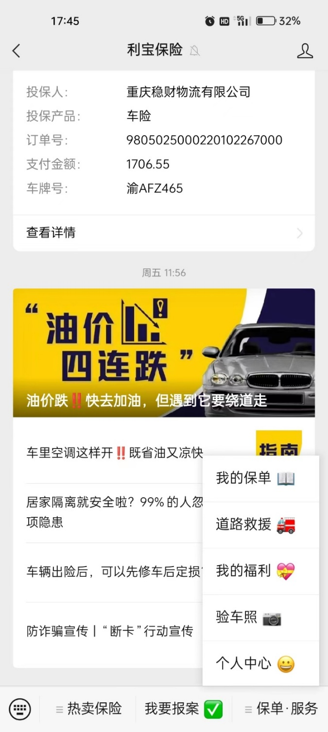
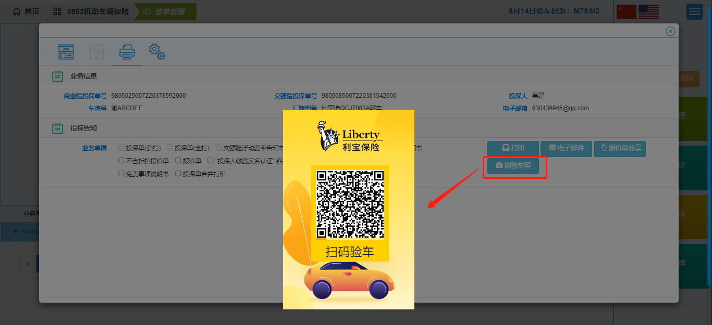
Portal
1
QR code from quote system
2
Official Account of Liberty Insurance

Slide 6
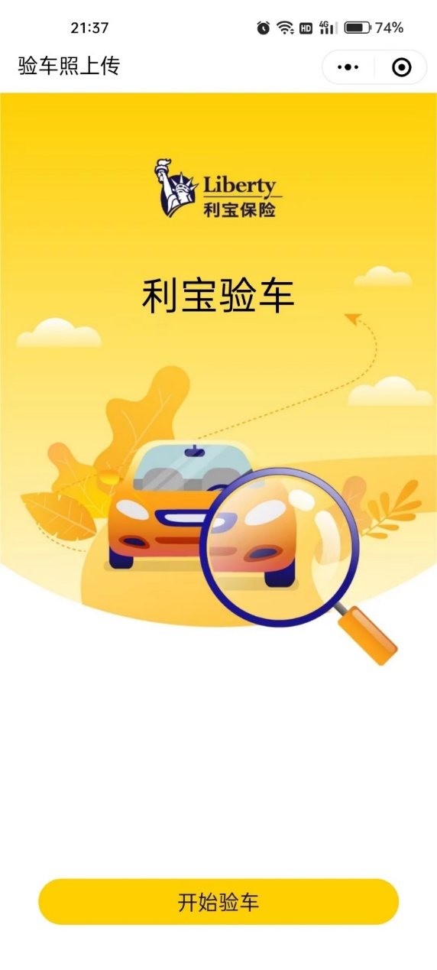
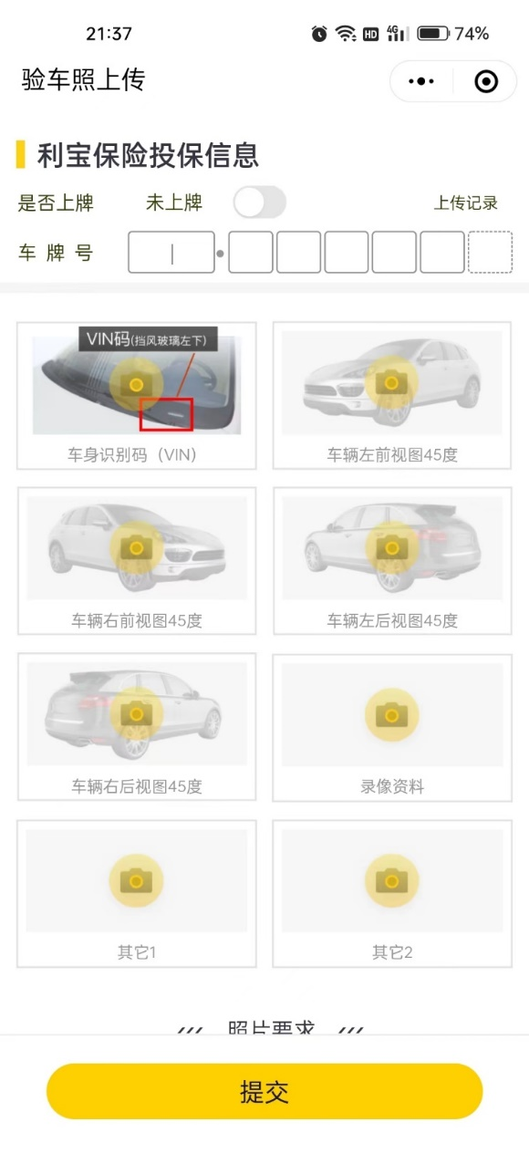
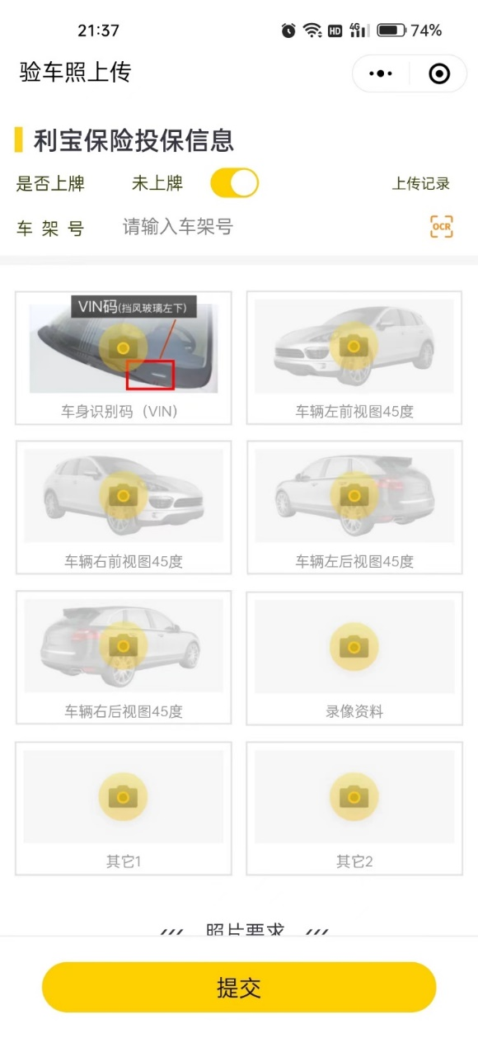
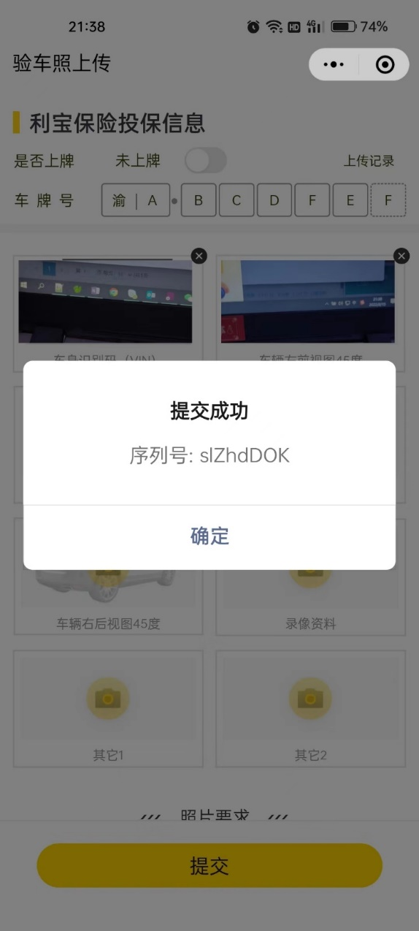
Instructions on uploading
Notes:
Take photos or videos in real-time
Can not select photos or videos form photo album

Slide 7
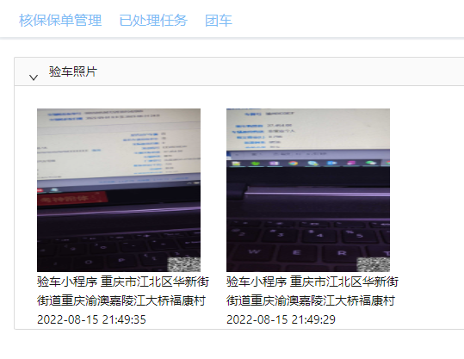
For underwriter
Notes:
核保人在核保的时候可以看到验车资料和其对应的上传时间和地点

